Slide 1
JavaScript: Client-Side Scripting
Chapter 6

Slide 2
Objectives
1
2
What is JavaScript
JavaScript Design
3
4
Using
JavaScript
Syntax
5
6
JavaScript
Objects
The DOM
7
7
JavaScript
Events
8
Forms

Slide 3
What IS Javascript
Section 1 of 8

Slide 4
What is JavaScript
JavaScript runs right inside the browser
JavaScript is dynamically typed
JavaScript is object oriented in that almost everything in the language is an object
the objects in JavaScript are prototype-based rather than class-based, which means that while JavaScript shares some syntactic features of PHP, Java or C#, it is also quite different from those languages

Slide 5
What isn’t JavaScript
It’s not Java
Although it contains the word Java, JavaScript and Java are vastly different programming languages with different uses. Java is a full-fledged compiled, object-oriented language, popular for its ability to run on any platform with a JVM installed.
Conversely, JavaScript is one of the world’s most popular languages, with fewer of the object-oriented features of Java, and runs directly inside the browser, without the need for the JVM.

Slide 6
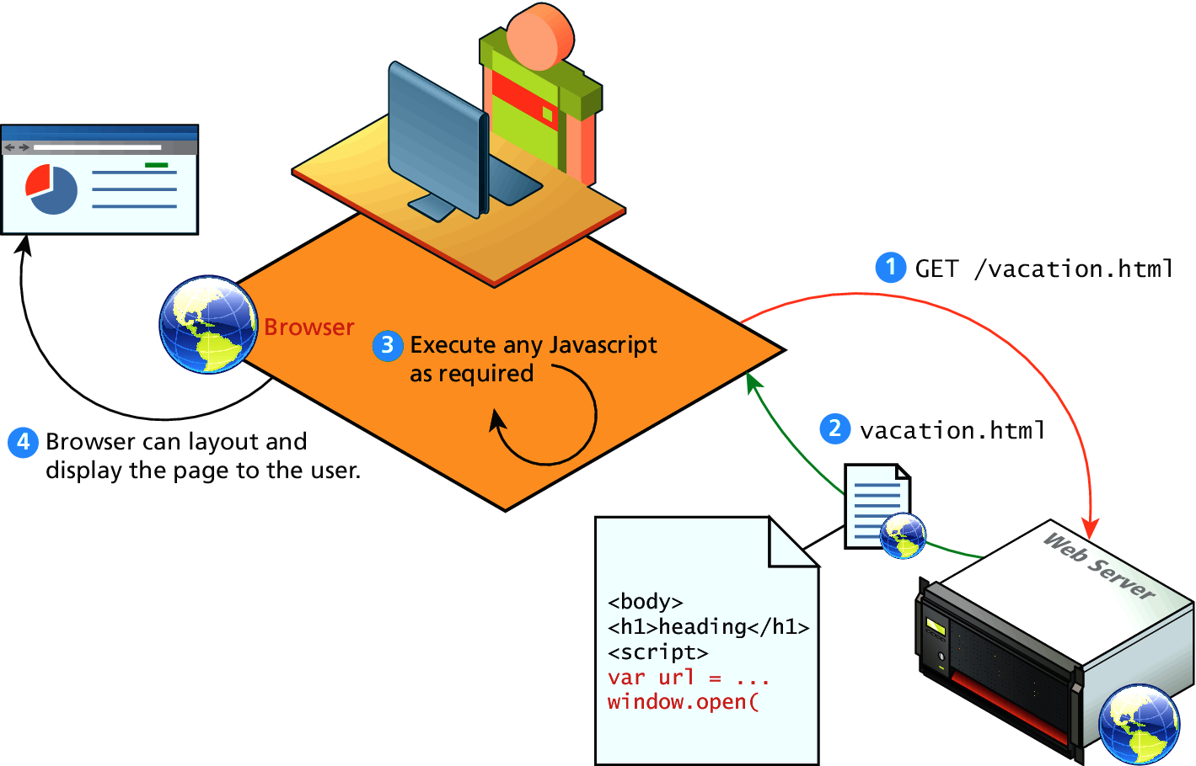
Client-Side Scripting
Let the client compute

Slide 7
Client-Side Scripting
It’s good
There are many advantages of client-side scripting:
Processing can be offloaded from the server to client machines, thereby reducing the load on the server.
The browser can respond more rapidly to user events than a request to a remote server ever could, which improves the user experience.
JavaScript can interact with the downloaded HTML in a way that the server cannot, creating a user experience more like desktop software than simple HTML ever could.

Slide 8
Client-Side Scripting
There are challenges
The disadvantages of client-side scripting are mostly related to how programmers use JavaScript in their applications.
There is no guarantee that the client has JavaScript enabled
The idiosyncrasies between various browsers and operating systems make it difficult to test for all potential client configurations. What works in one browser, may generate an error in another.
JavaScript-heavy web applications can be complicated to debug and maintain.

Slide 9
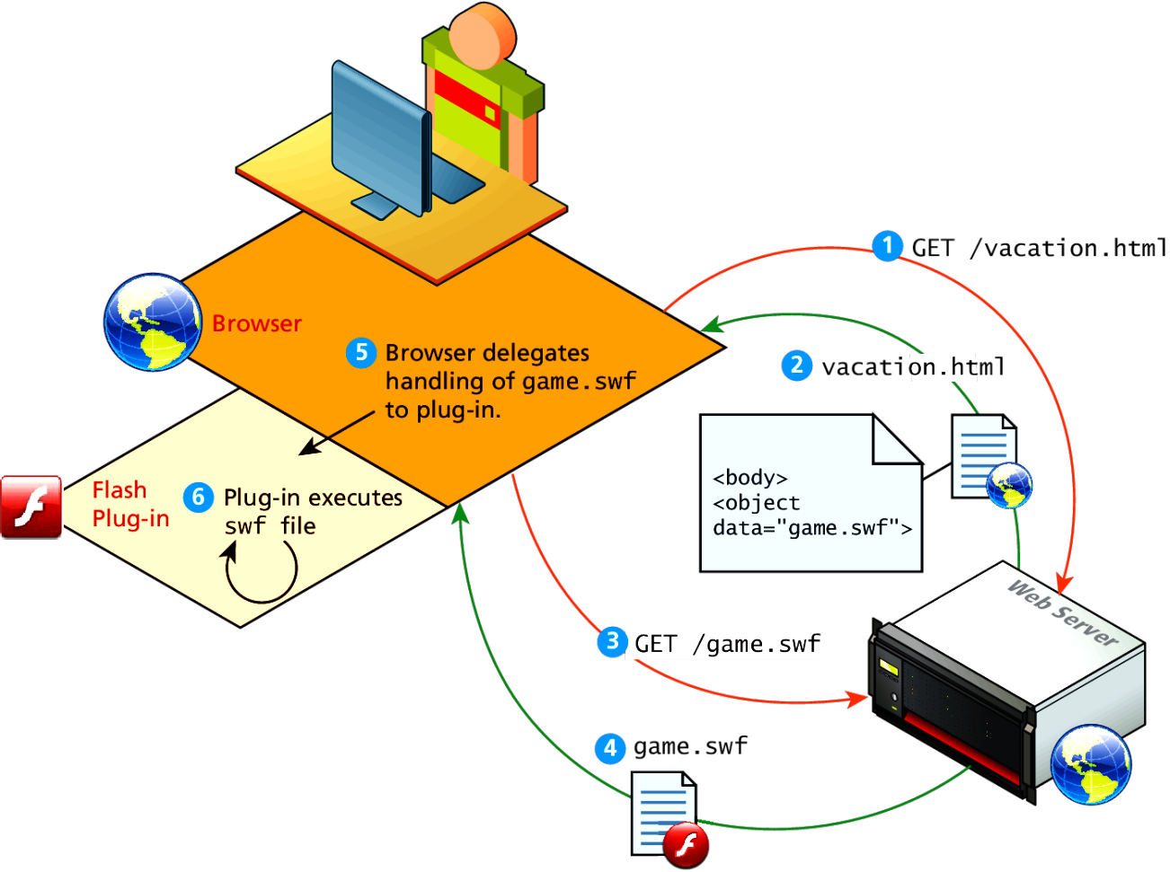
Client-Side Flash
JavaScript is not the only type of client-side scripting.
Browser Plug-ins
Flash

Slide 10
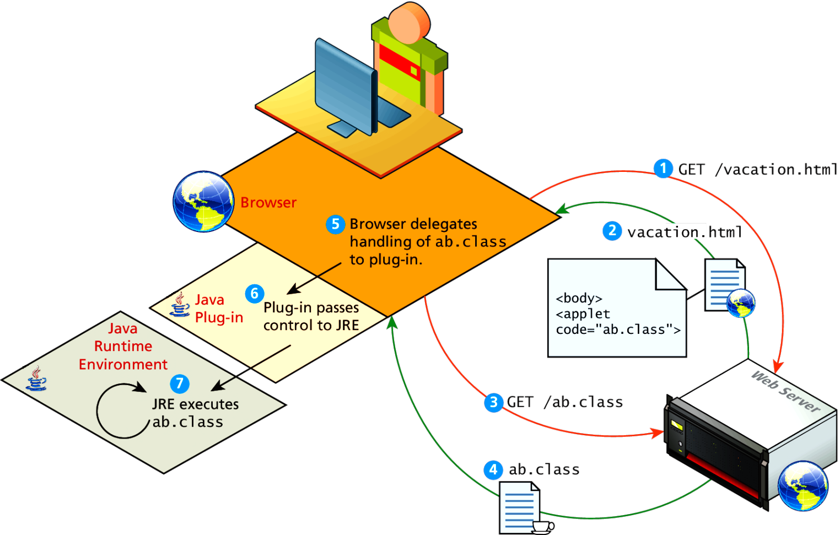
Client-Side Applets
Java Applets
Java applets are written in and are separate objects included within an HTML document via the <applet> tag

Slide 11
JavaScript History
JavaScript was introduced by Netscape in their Navigator browser back in 1996.
JavaScript is in fact an implementation of a standardized scripting language called ECMAScript
JavaScript was only slightly useful, and quite often, very annoying tomany users

Slide 12
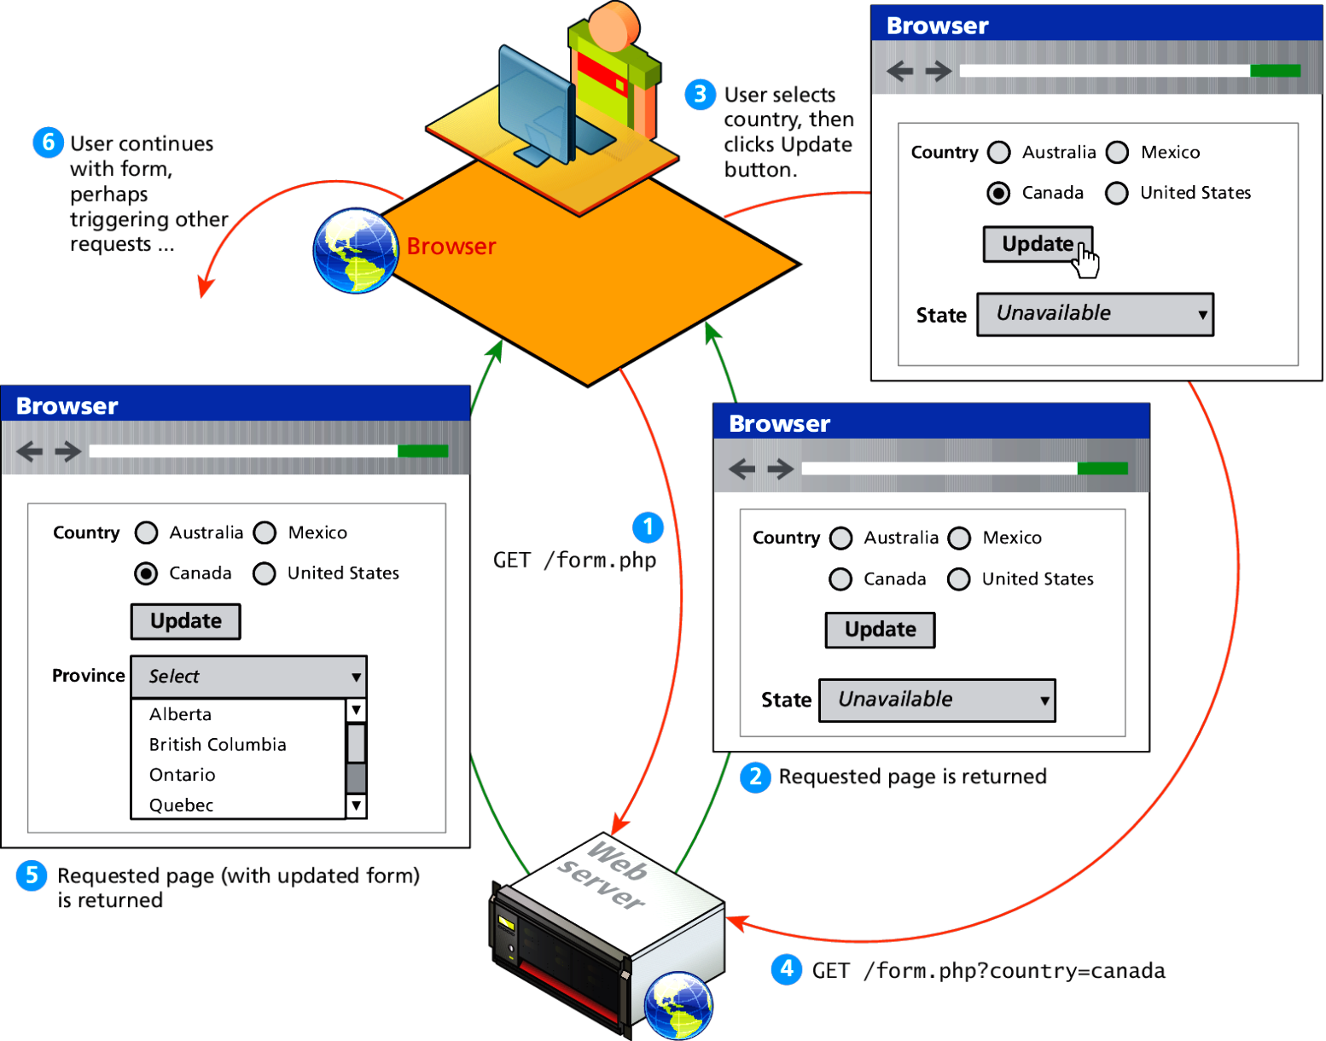
HTTP request-reponse loop
Without JavaScript

Slide 13
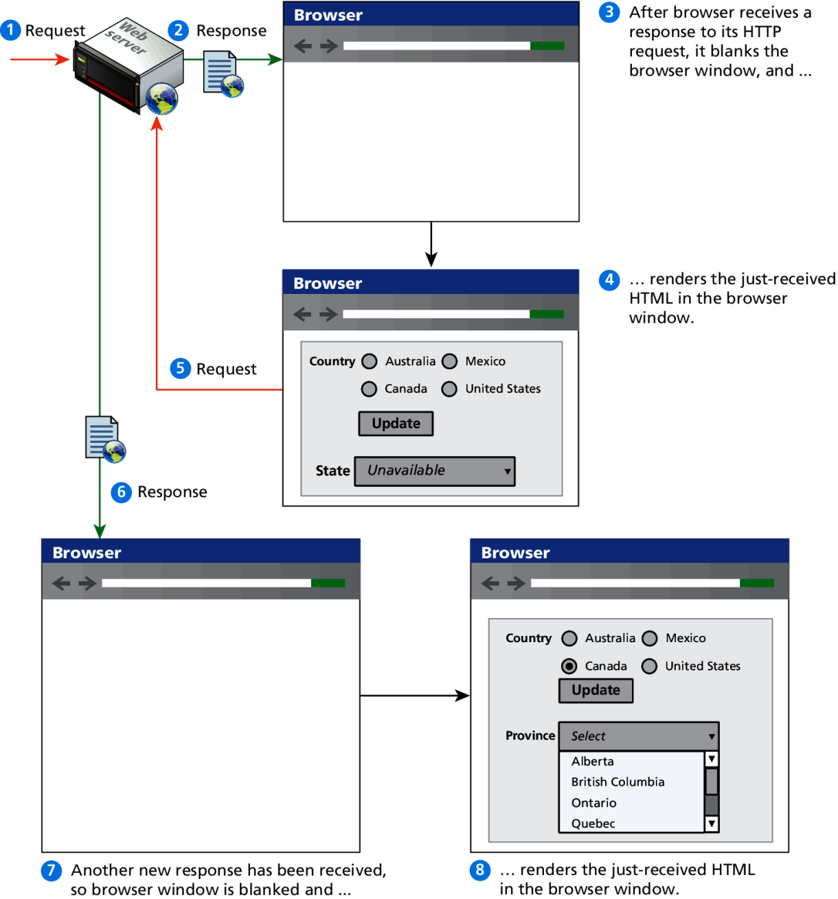
HTTP request-reponse loop
Detail

Slide 14
JavaScript in Modern Times
AJAX
JavaScript became a much more important part of web development in the mid 2000s with AJAX.
AJAX is both an acronym as well as a general term.
As an acronym it means Asynchronous JavaScript And XML.
The most important feature of AJAX sites is the asynchronous data requests.

Slide 15
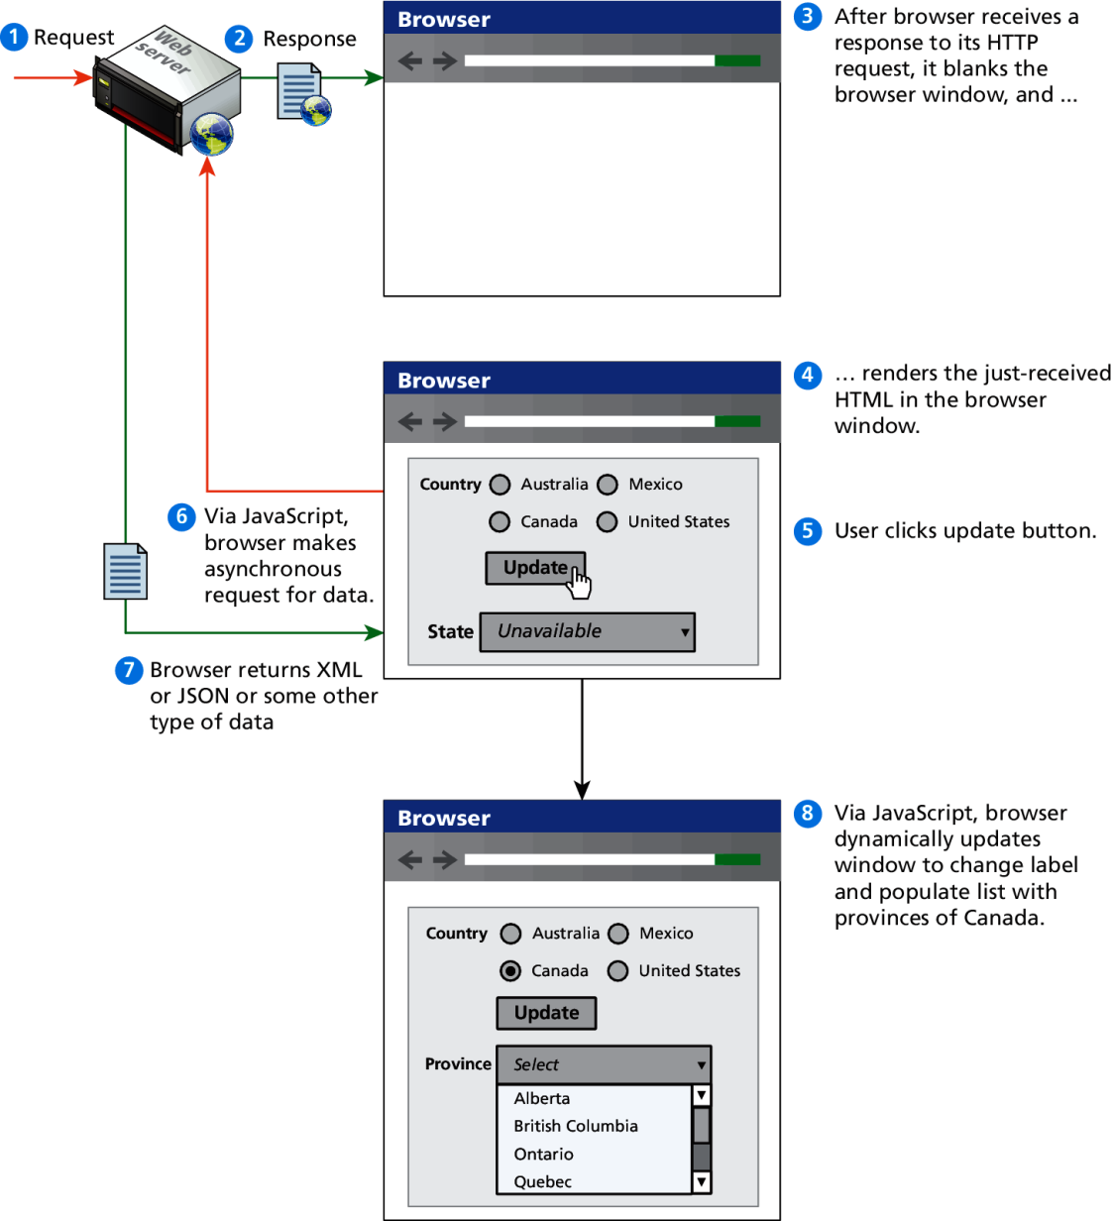
Asynchronous data requests
The better AJAX way

Slide 16
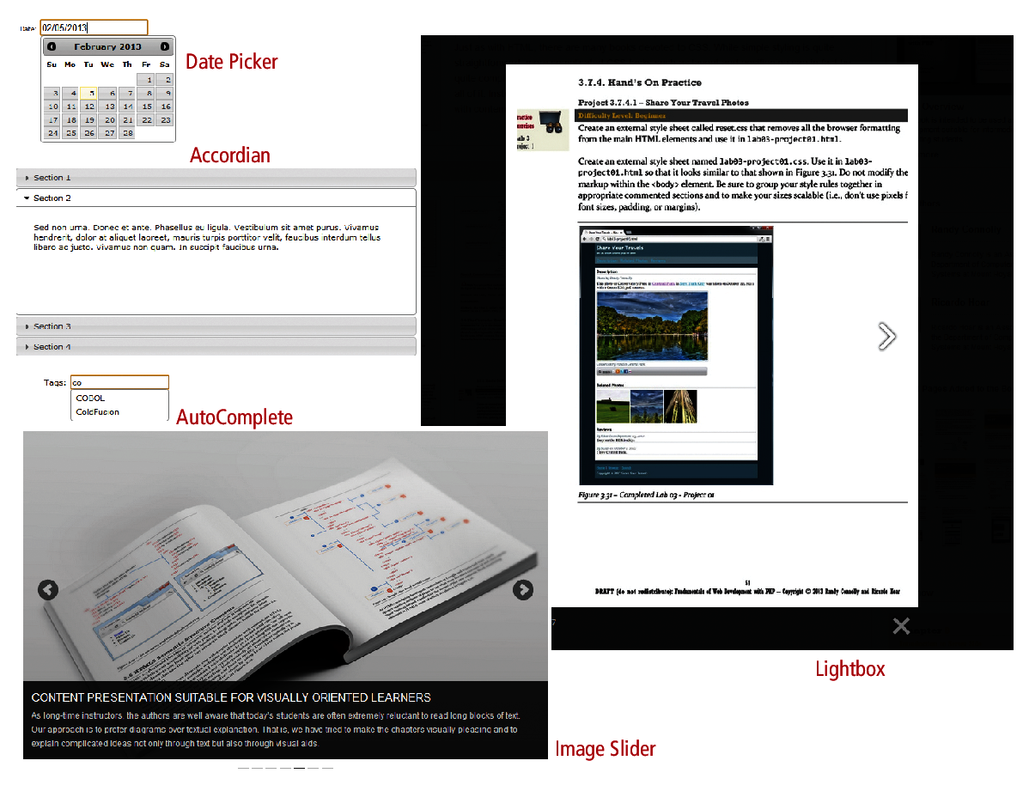
Frameworks
Lots of this is done for you, once you get the basics

Slide 17
Javascript Design Principles
Section 2 of 8

Slide 18
Layers
They help organize
When designing software to solve a problem, it is often helpful to abstract the solution a little bit to help build a cognitive model in your mind that you can then implement.
Perhaps the most common way of articulating such a cognitive model is via the term layer.
In object-oriented programming, a software layer is a way of conceptually grouping programming classes that have similar functionality and dependencies.

Slide 19
Layers
Common Layers
Presentation layer. Classes focused on the user interface.
Business layer. Classes that model real-world entities, such as customers, products, and sales.
Data layer. Classes that handle the interaction with the data sources.

Slide 20
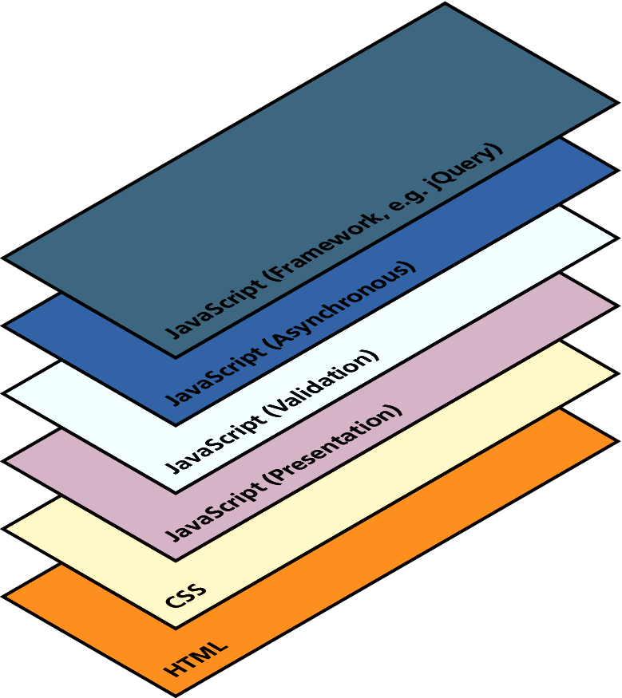
Layers
Just a conceptual idea

Slide 21
Users Without Javascript
They do exist
Web crawler. A web crawler is a client running on behalf of a search engine to download your site, so that it can eventually be featured in their search results.
Browser plug-in. A browser plug-in is a piece of software that works within the browser, that might interfere with JavaScript.
Text-based client. Some clients are using a text-based browser.
Visually disabled client. A visually disabled client will use special web browsing software to read the contents of a web page out loud to them.

Slide 22
Users Without Javascript
Lynx, and WebIE

Slide 23
The <noscript> tag
Mechanism to speak to those with JavaScript
Any text between the opening and closing tags will only be displayed to users without the ability to load JavaScript.
It is often used to prompt users to enable JavaScript, but can also be used to show additional text to search engines.
Requiring JavaScript (or Flash) for the basic operation of your site will cause problems eventually and should be avoided.
This approach of adding functional replacements for those without JavaScript is also referred to as fail-safe design, which is a phrase with a meaning beyond web development.

Slide 24
Graceful Degradation and Progressive Enhancement
Over the years, browser support for different JavaScript objects has varied. Something that works in the current version of Chrome might not work in IE version 8; something that works in a desktop browser might not work in a mobile browser.
There are two strategies:
graceful degradation
progressive enhancement

Slide 25
Graceful Degradation
With this strategy you develop your site for the abilities of current browsers.
For those users who are not using current browsers, you might provide an alternate site or pages for those using older browsers that lack the JavaScript (or CSS or HTML5) used on the main site.
The idea here is that the site is “degraded” (i.e., loses capability) “gracefully” (i.e., without pop-up JavaScript error codes or without condescending messages telling users to upgrade their browsers)

Slide 26
Graceful Degradation

Slide 27
Progressive Enhancement
In this case, the developer creates the site using CSS, JavaScript, and HTML features that are supported by all browsers of a certain age or newer.
To that baseline site, the developers can now “progressively” (i.e., for each browser) “enhance” (i.e., add functionality) to their site based on the capabilities of the users’ browsers.

Slide 28
Progressive Enhancement

Slide 29
Where Does Javascript GO?
Section 3 of 8

Slide 30
Where does JavaScript go?
JavaScript can be linked to an HTML page in a number of ways.
Inline
Embedded
External

Slide 31
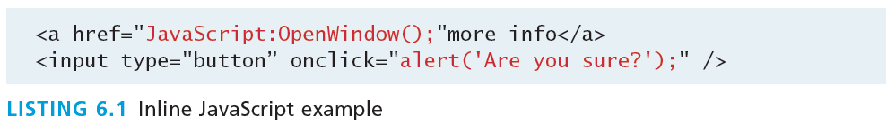
Inline JavaScript
Mash it in
Inline JavaScript refers to the practice of including JavaScript code directly within certain HTML attributes
Inline JavaScript is a real maintenance nightmare

Slide 32
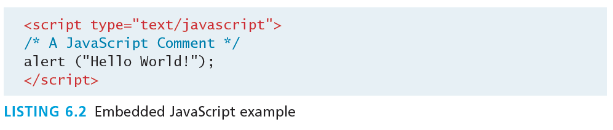
Embedded JavaScript
Better
Embedded JavaScript refers to the practice of placing JavaScript code within a <script> element

Slide 33
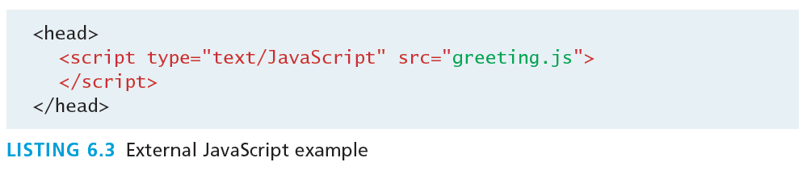
External JavaScript
Better
JavaScript supports this separation by allowing links to an external file that contains the JavaScript.
By convention, JavaScript external files have the extension .js.

Slide 34
Advanced Inclusion
In production sites, advanced techniques are used
Generate embedded styles to reduce requests
Code still managed in a external file
<iframe> loading
Asynchronus load from another JavaScript file
Faster initial load

Slide 35
Syntax
Section 4 of 8

Slide 36
JavaScript Syntax
We will briefly cover the fundamental syntax for the most common programming constructs including
variables,
assignment,
conditionals,
loops, and
arrays
before moving on to advanced topics such as events and classes.

Slide 37
JavaScript’s Reputation
Precedes it?
JavaScript’s reputation for being quirky not only stems from its strange way of implementing object-oriented principles but also from some odd syntactic gotchas:
Everything is type sensitive, including function, class, and variable names.
The scope of variables in blocks is not supported. This means variables declared inside a loop may be accessible outside of the loop, counter to what one would expect.
There is a === operator, which tests not only for equality but type equivalence.
Null and undefined are two distinctly different states for a variable.
Semicolons are not required, but are permitted (and encouraged).
There is no integer type, only number, which means floating-point rounding errors are prevalent even with values intended to be integers.

Slide 38
Variables
var
Variables in JavaScript are dynamically typed, meaning a variable can be an integer, and then later a string, then later an object, if so desired.
This simplifies variable declarations, so that we do not require the familiar type fields like int, char, and String. Instead we use var
Assignment can happen at declaration-time by appending the value to the declaration, or at run time with a simple right-to-left assignment

Slide 39
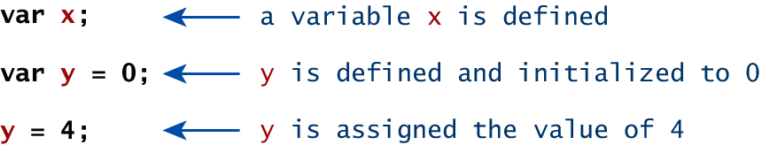
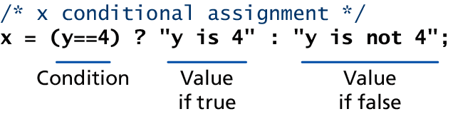
Variables
Assignment

Slide 40
Comparison Operators
True or not True
Operator | Description | Matches (x=9)
== | Equals | (x==9) is true (x=="9") is true
=== | Exactly equals, including type | (x==="9") is false (x===9) is true
< , > | Less than, Greater Than | (x<5) is false
<= , >= | Less than or equal, greater than or equal | (x<=9) is true
!= | Not equal | (4!=x) is true
!== | Not equal in either value or type | (x!=="9") is true (x!==9) is false

Slide 41
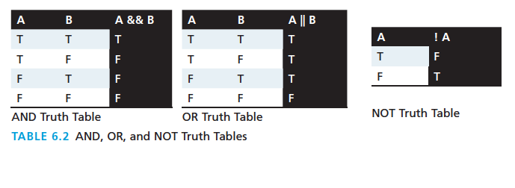
Logical Operators
The Boolean operators and, or, and not and their truth tables are listed in Table 6.2. Syntactically they are represented with && (and), || (or), and ! (not).

Slide 42
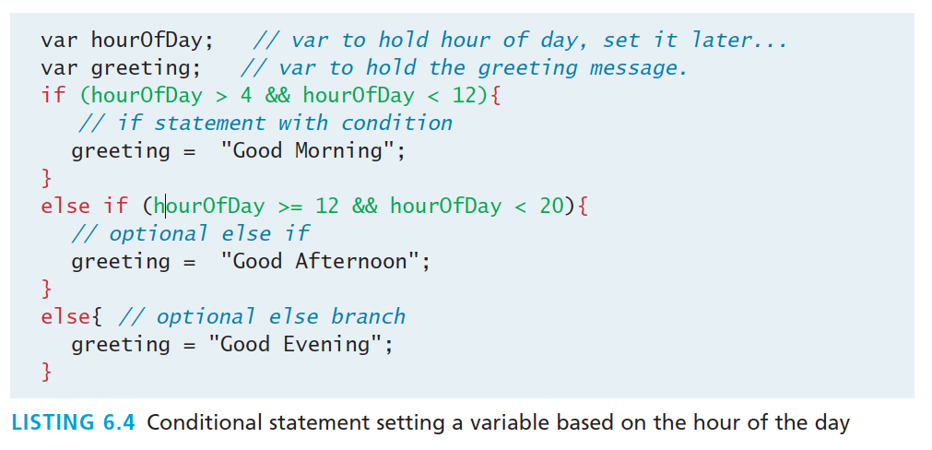
Conditionals
If, else if, …, else
JavaScript’s syntax is almost identical to that of PHP, Java, or C when it comes to conditional structures such as if and if else statements. In this syntax the condition to test is contained within ( ) brackets with the body contained in { } blocks.

Slide 43
Loops
Round and round we go
Like conditionals, loops use the ( ) and { } blocks to define the condition and the body of the loop.
You will encounter the while and for loops
While loops normally initialize a loop control variable before the loop, use it in the condition, and modify it within the loop.
var i=0; // initialise the Loop Control Variable
while(i < 10){ //test the loop control variable
i++; //increment the loop control variable
}

Slide 44
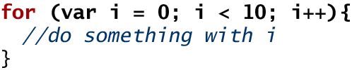
For Loops
Counted loops
A for loop combines the common components of a loop: initialization, condition, and post-loop operation into one statement.
This statement begins with the for keyword and has the components placed between ( ) brackets, semicolon (;) separated as shown

Slide 45
Functions
Functions are the building block for modular code in JavaScript, and are even used to build pseudo-classes, which you will learn about later.
They are defined by using the reserved word function and then the function name and (optional) parameters.
Since JavaScript is dynamically typed, functions do not require a return type, nor do the parameters require type.

Slide 46
Functions
Example
Therefore a function to raise x to the yth power might be defined as:
function power(x,y){
var pow=1;
for (var i=0;i<y;i++){
pow = pow*x;
}
return pow;
}
And called as
power(2,10);

Slide 47
Alert
Not really used anymore, console instead
The alert() function makes the browser show a pop-up to the user, with whatever is passed being the message displayed. The following JavaScript code displays a simple hello world message in a pop-up:
alert ( "Good Morning" );
Using alerts can get tedious fast. When using debugger tools in your browser you can write output to a log with:
console.log("Put Messages Here");
And then use the debugger to access those logs.

Slide 48
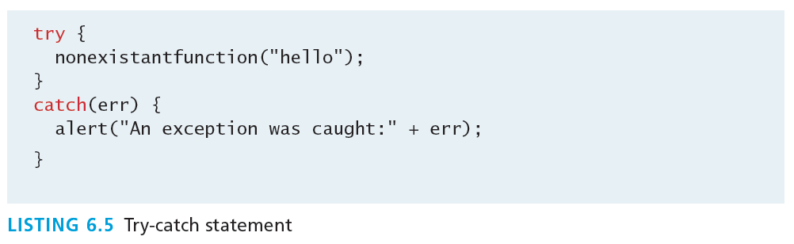
Errors using try and catch
When the browser’s JavaScript engine encounters an error, it will throw an exception. These exceptions interrupt the regular, sequential execution of the program and can stop the JavaScript engine altogether. However, you can optionally catch these errors preventing disruption of the program using the try–catch block

Slide 49
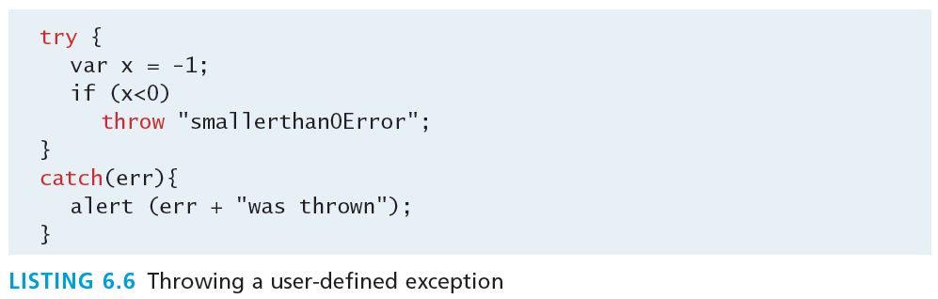
Throw your own
Exceptions that is.
Although try-catch can be used exclusively to catch built-in JavaScript errors, it can also be used by your programs, to throw your own messages. The throw keyword stops normal sequential execution, just like the built-in exceptions

Slide 50
Tips
With Exceptions
Try-catch and throw statements should be used for abnormal or exceptional cases in your program.
Throwing an exception disrupts the sequential execution of a program. When the exception is thrown all subsequent code is not executed until the catch statement is reached.
This reinforces why try-catch is for exceptional cases.

Slide 51
Javascript Objects
Section 5 of 8

Slide 52
JavaScript Objects
Objects not Classes
JavaScript is not a full-fledged object-oriented programming language.
It does not have classes per se, and it does not support many of the patterns you’d expect from an object-oriented language like inheritance and polymorphism.
The language does, however, support objects.

Slide 53
JavaScript Objects
Not full-fledged O.O.
Objects can have constructors, properties, and methods associated with them.
There are objects that are included in the JavaScript language; you can also define your own kind of objects.

Slide 54
Constructors
Normally to create a new object we use the new keyword, the class name, and ( ) brackets with n optional parameters inside, comma delimited as follows:
var someObject = new ObjectName(p1,p2,..., pn);
For some classes, shortcut constructors are defined
var greeting = "Good Morning";
vs the formal:
var greeting = new String("Good Morning");

Slide 55
Properties
Use the dot
Each object might have properties that can be accessed, depending on its definition.
When a property exists, it can be accessed using dot notation where a dot between the instance name and the property references that property.
//show someObject.property to the user alert(someObject.property);

Slide 56
Methods
Use the dot, with brackets
Objects can also have methods, which are functions associated with an instance of an object. These methods are called using the same dot notation as for properties, but instead of accessing a variable, we are calling a method.
someObject.doSomething();
Methods may produce different output depending on the object they are associated with because they can utilize the internal properties of the object.

Slide 57
Objects Included in JavaScript
A number of useful objects are included with JavaScript including:
Array
Boolean
Date
Math
String
Dom objects

Slide 58
Arrays
Arrays are one of the most used data structures. In practice, this class is defined to behave more like a linked list in that it can be resized dynamically, but the implementation is browser specific, meaning the efficiency of insert and delete operations is unknown.
The following code creates a new, empty array named greetings:
var greetings = new Array();

Slide 59
Arrays
Initialize with values
To initialize the array with values, the variable declaration would look like the following:
var greetings = new Array("Good Morning", "Good Afternoon");
or, using the square bracket notation:
var greetings = ["Good Morning", "Good Afternoon"];

Slide 60
Arrays
Access and Traverse
To access an element in the array you use the familiar square bracket notation from Java and C-style languages, with the index you wish to access inside the brackets.
alert ( greetings[0] );
One of the most common actions on an array is to traverse through the items sequentially. Using the Array object’s length property to determine the maximum valid index. We have:
for (var i = 0; i < greetings.length; i++){
alert(greetings[i]);
}

Slide 61
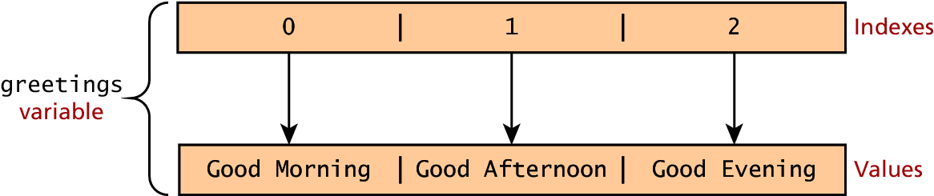
Arrays
Index and Value

Slide 62
Arrays
Modifying an array
To add an item to an existing array, you can use the push method.
greetings.push("Good Evening");
The pop method can be used to remove an item from the back of an array.
Additional methods: concat(), slice(), join(), reverse(), shift(), and sort()

Slide 63
Math
The Math class allows one to access common mathematic functions and common values quickly in one place.
This static class contains methods such as max(), min(), pow(), sqrt(), and exp(), and trigonometric functions such as sin(), cos(), and arctan().
Many mathematical constants are defined such as PI, E, SQRT2, and some others
Math.PI; // 3.141592657
Math.sqrt(4); // square root of 4 is 2.
Math.random(); // random number between 0 and 1

Slide 64
String
The String class has already been used without us even knowing it.
Constructor usage
var greet = new String("Good"); // long form constructor
var greet = "Good"; // shortcut constructor
Length of a string
alert (greet.length); // will display "4"

Slide 65
String
Concatenation and so much more
var str = greet.concat("Morning"); // Long form concatenation
var str = greet + "Morning"; // + operator concatenation
Many other useful methods exist within the String class, such as
accessing a single character using charAt()
searching for one using indexOf().
Strings allow splitting a string into an array, searching and matching with split(), search(), and match() methods.

Slide 66
Date
Not that kind
The Date class is yet another helpful included object you should be aware of. It allows you to quickly calculate the current date or create date objects for particular dates. To display today’s date as a string, we would simply create a new object and use the toString() method.
var d = new Date();
// This outputs Today is Mon Nov 12 2012 15:40:19 GMT-0700
alert ("Today is "+ d.toString());

Slide 67
Window
The window object in JavaScript corresponds to the browser itself. Through it, you can access the current page’s URL, the browser’s history, and what’s being displayed in the status bar, as well as opening new browser windows.
In fact, the alert() function mentioned earlier is actually a method of the window object.

Slide 68
The Document Object Model (DOM)
Section 6 of 8

Slide 69
The DOM
Document Object Model
JavaScript is almost always used to interact with the HTML document in which it is contained.
This is accomplished through a programming interface (API) called the Document Object Model.
According to the W3C, the DOM is a:
Platform- and language-neutral interface that will allow programs and scripts to dynamically access and update the content, structure and style of documents.

Slide 70
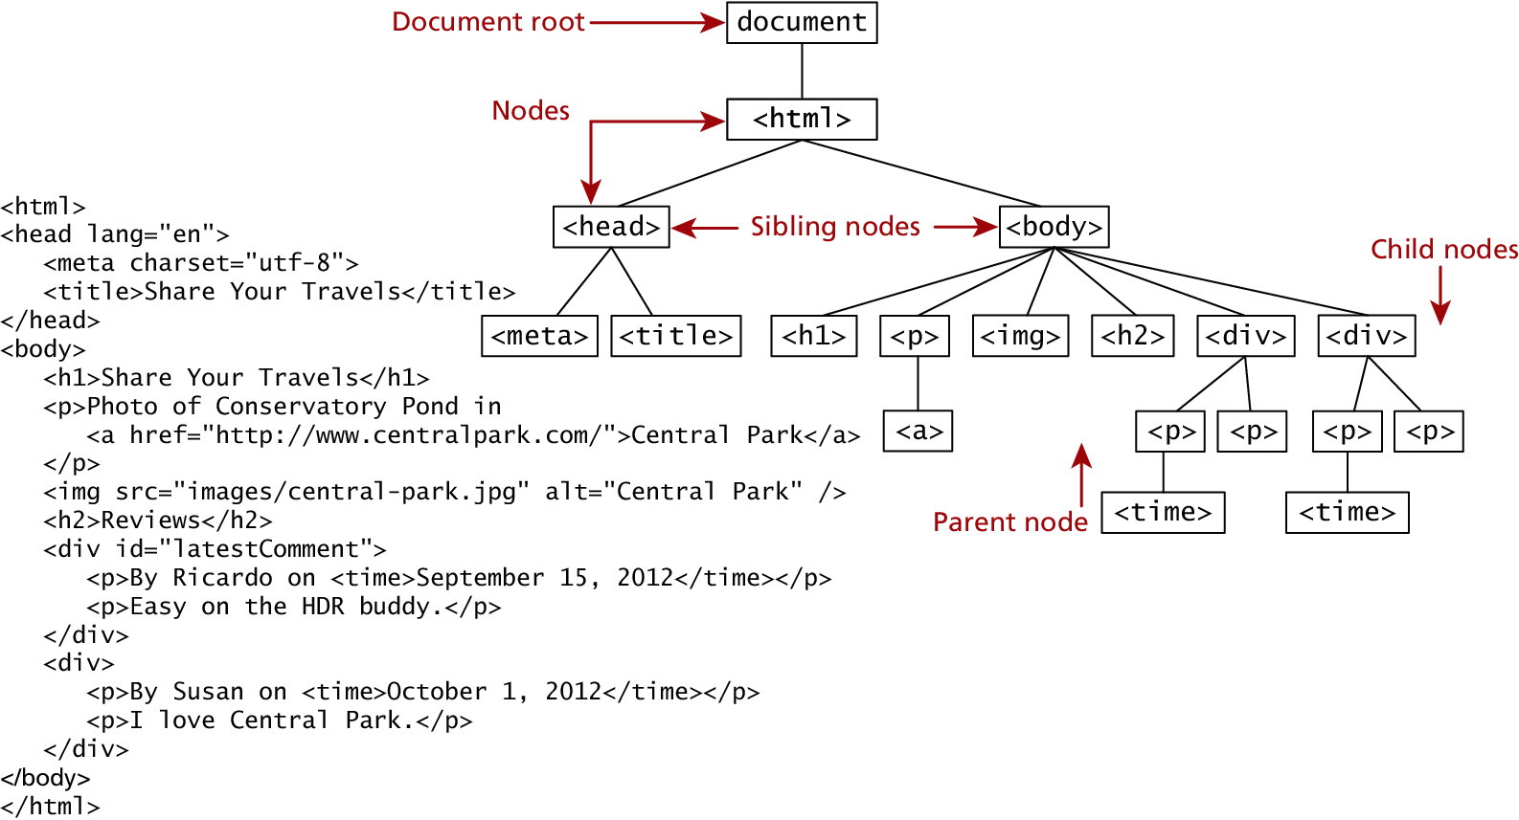
The DOM
Seems familiar, because it is!
We already know all about the DOM, but by another name. The tree structure from Chapter 2 (HTML) is formally called the DOM Tree with the root, or topmost object called the Document Root.

Slide 71
DOM Nodes
In the DOM, each element within the HTML document is called a node. If the DOM is a tree, then each node is an individual branch.
There are:
element nodes,
text nodes, and
attribute nodes
All nodes in the DOM share a common set of properties and methods.

Slide 72
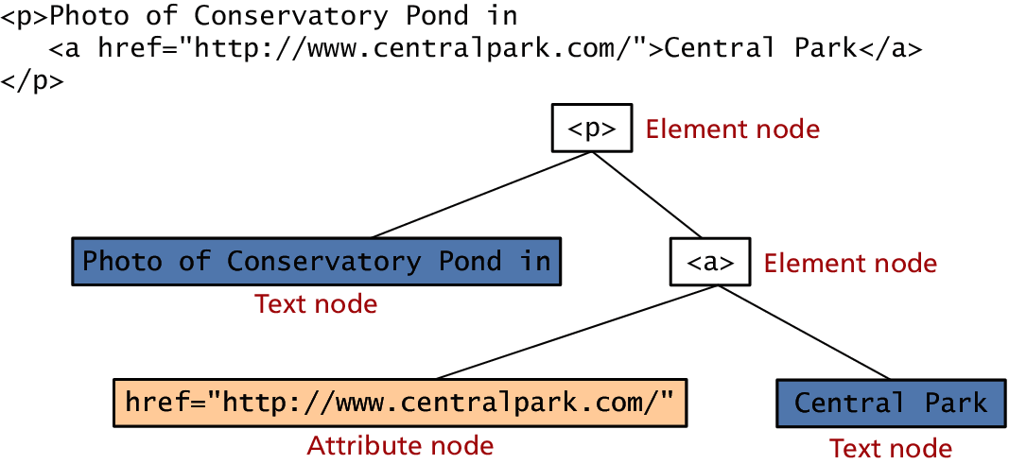
DOM Nodes
Element, text and attribute nodes

Slide 73
DOM Nodes
Essential Node Object properties
Property | Description
attributes | Collection of node attributes
childNodes | A NodeList of child nodes for this node
firstChild | First child node of this node.
lastChild | Last child of this node.
nextSibling | Next sibling node for this node.
nodeName | Name of the node
nodeType | Type of the node
nodeValue | Value of the node
parentNode | Parent node for this node.
previousSibling | Previous sibling node for this node.

Slide 74
Document Object
One root to ground them all
The DOM document object is the root JavaScript object representing the entire HTML document.
It contains some properties and methods that we will use extensively in our development and is globally accessible as document.
// specify the doctype, for example html
var a = document.doctype.name;
// specify the page encoding, for example ISO-8859-1
var b = document.inputEncoding;

Slide 75
Document Object
Document Object Methods
Method | Description
createAttribute() | Creates an attribute node
createElement() | Creates an element node
createTextNode() | Create a text node
getElementById(id) | Returns the element node whose id attribute matches the passed id parameter.
getElementsByTagName(name) | Returns a nodeList of elements whose tag name matches the passed name parameter.

Slide 76
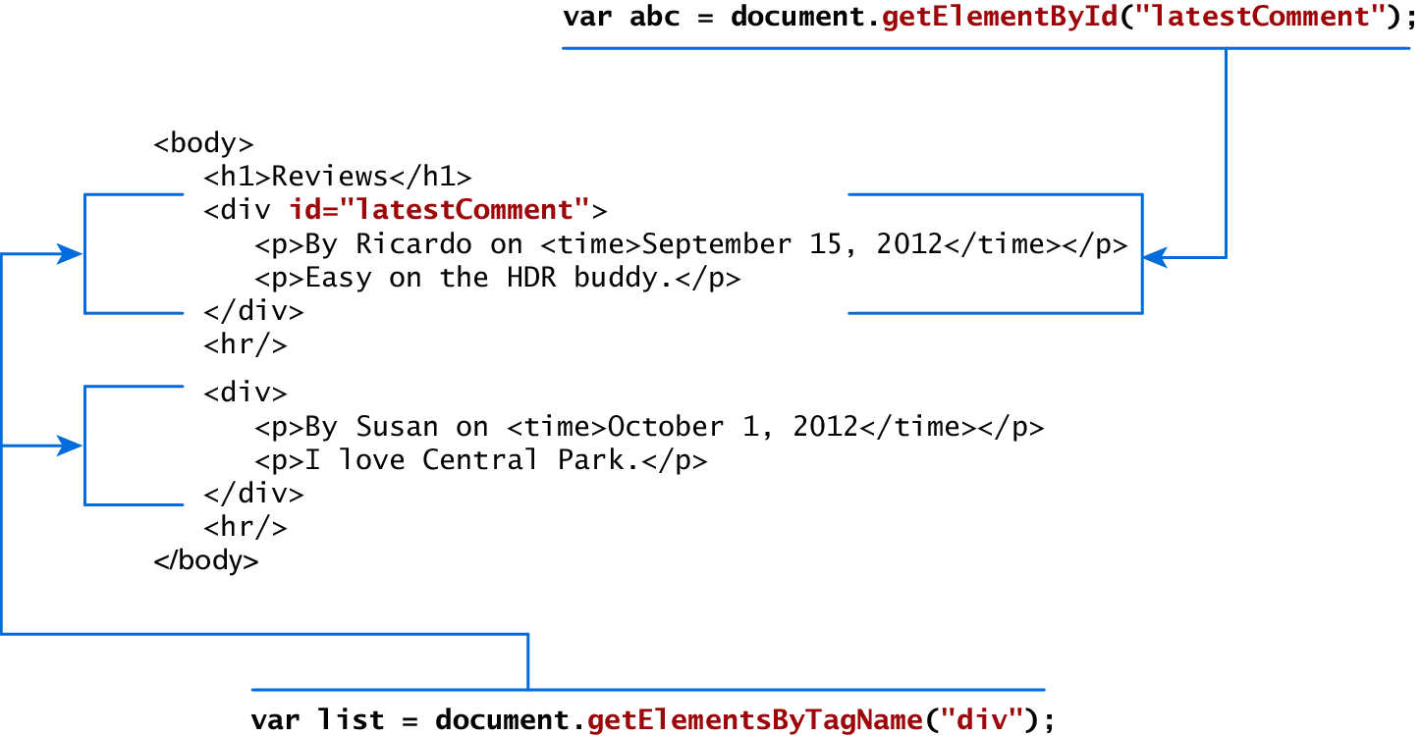
Accessing nodes
getElementById(), getElementsByTagName()

Slide 77
Element node Object
The type of object returned by the method document.getElementById() described in the previous section is an element node object.
This represents an HTML element in the hierarchy, contained between the opening <> and closing </> tags for this element.
can itself contain more elements

Slide 78
Element node Object
Essential Element Node Properties
Property | Description
className | The current value for the class attribute of this HTML element.
id | The current value for the id of this element.
innerHTML | Represents all the things inside of the tags. This can be read or written to and is the primary way which we update particular div's using JS.
style | The style attribute of an element. We can read and modify this property.
tagName | The tag name for the element.

Slide 79
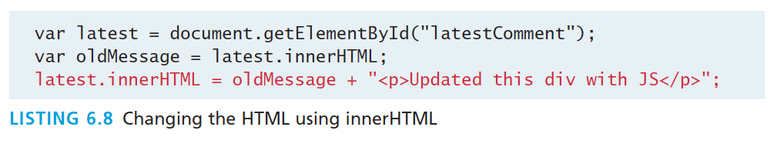
Modifying a DOM element
The document.write() method is used to create output to the HTML page from JavaScript. The modern JavaScript programmer will want to write to the HTML page, but in a particular location, not always at the bottom
Using the DOM document and HTML DOM element objects, we can do exactly that using the innerHTML property

Slide 80
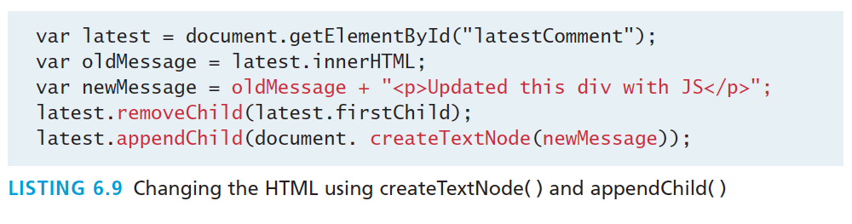
Modifying a DOM element
More verbosely, and validated
Although the innerHTML technique works well (and is very fast), there is a more verbose technique available to us that builds output using the DOM.
DOM functions createTextNode(), removeChild(), and appendChild() allow us to modify an element in a more rigorous way

Slide 81
Changing an element’s style
We can add or remove any style using the style or className property of the Element node.
Its usage is shown below to change a node’s background color and add a three-pixel border.
var commentTag = document.getElementById("specificTag");
commentTag.style.backgroundColour = "#FFFF00";
commentTag.style.borderWidth="3px";

Slide 82
Changing an element’s style
With class
The className property is normally a better choice, because it allows the styles to be created outside the code, and thus be better accessible to designers.
var commentTag = document.getElementById("specificTag");
commentTag.className = "someClassName";
HTML5 introduces the classList element, which allows you to add, remove, or toggle a CSS class on an element.
label.classList.addClass("someClassName");

Slide 83
More Properties
Some Specific HTML DOM Element Properties for Certain Tag Types
Property | Description | Tags
href | The href attribute used in a tags to specify a URL to link to. | a
name | The name property is a bookmark to identify this tag. Unlike id which is available to all tags, name is limited to certain form related tags. | a, input, textarea, form
src | Links to an external URL that should be loaded into the page (as opposed to href which is a link to follow when clicked) | img, input, iframe, script
value | The value is related tot he value attribute of input tags. Often the value of an input field is user defined, and we use value to get that user input. | Input, textarea, submit

Slide 84
JavaScript Events
Section 7 of 8

Slide 85
JavaScript Events
A JavaScript event is an action that can be detected by JavaScript.
We say then that an event is triggered and then it can be caught by JavaScript functions, which then do something in response.

Slide 86
JavaScript Events
A brave new world
In the original JavaScript world, events could be specified right in the HTML markup with hooks to the JavaScript code (and still can).
As more powerful frameworks were developed, and website design and best practices were refined, this original mechanism was supplanted by the listener approach.

Slide 87
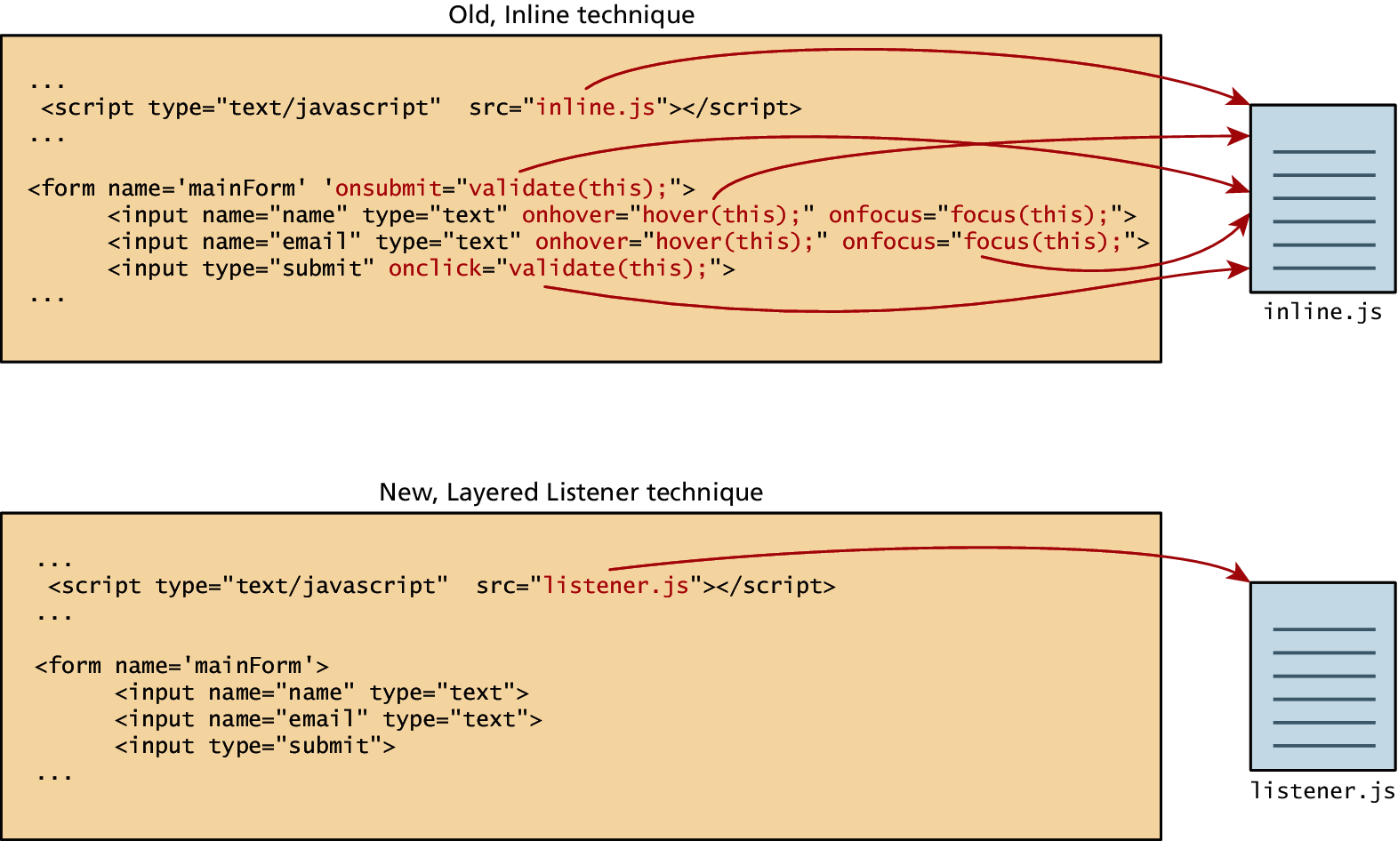
JavaScript Events
Two approaches

Slide 88
Inline Event Handler Approach
For example, if you wanted an alert to pop-up when clicking a <div> you might program:
<div id="example1" onclick="alert('hello')">Click for pop-up</div>
The problem with this type of programming is that the HTML markup and the corresponding JavaScript logic are woven together. It does not make use of layers; that is, it does not separate content from behavior.

Slide 89
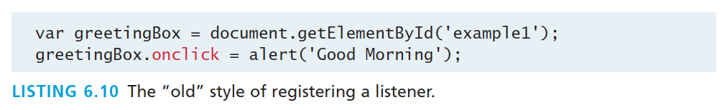
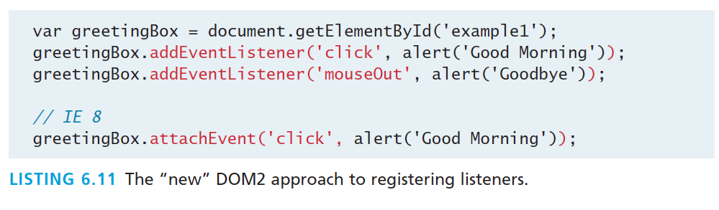
Listener Approach
Two ways to set up listeners

Slide 90
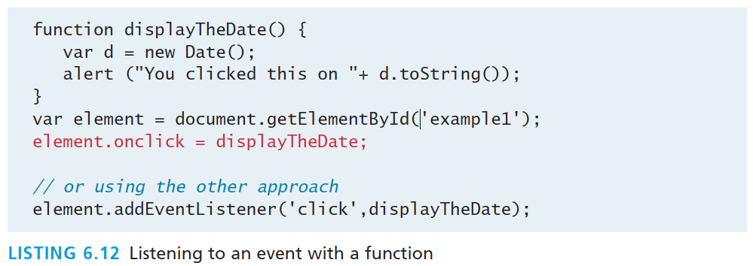
Listener Approach
Using functions
What if we wanted to do something more elaborate when an event is triggered? In such a case, the behavior would have to be encapsulated within a function, as shown in Listing 6.12.

Slide 91
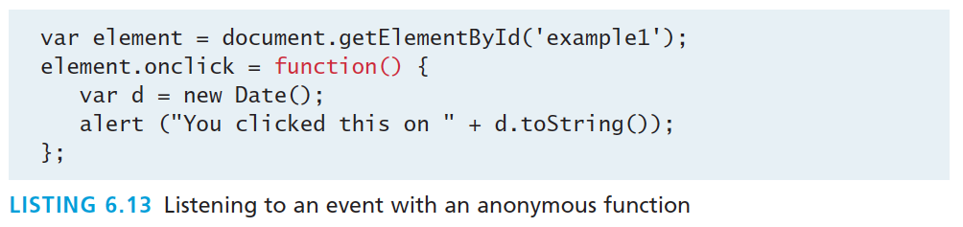
Listener Approach
Anonymous functions
An alternative to that shown in Listing 6.12 is to use an anonymous function (that is, one without a name), as shown in Listing 6.13.

Slide 92
Event Object
No matter which type of event we encounter, they are all DOM event objects and the event handlers associated with them can access and manipulate them. Typically we see the events passed to the function handler as a parameter named e.
function someHandler(e) {
// e is the event that triggered this handler.
}

Slide 93
Event Object
Several Options
Bubbles. If an event’s bubbles property is set to true then there must be an event handler in place to handle the event or it will bubble up to its parent and trigger an event handler there.
Cancelable. The Cancelable property is also a Boolean value that indicates whether or not the event can be cancelled.
preventDefault. A cancelable default action for an event can be stopped using the preventDefault() method in the next slide

Slide 94
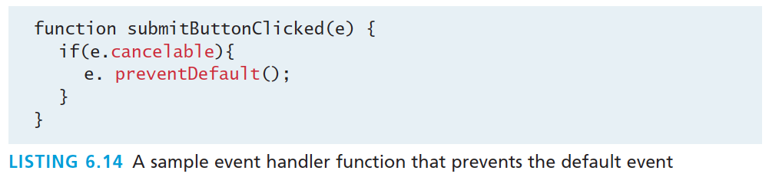
Event Object
Prevent the default behaviour

Slide 95
Event Types
There are several classes of event, with several types of event within each class specified by the W3C:
mouse events
keyboard events
form events
frame events

Slide 96
Mouse events
Event | Description
onclick | The mouse was clicked on an element
ondblclick | The mouse was double clicked on an element
onmousedown | The mouse was pressed down over an element
onmouseup | The mouse was released over an element
onmouseover | The mouse was moved (not clicked) over an element
onmouseout | The mouse was moved off of an element
onmousemove | The mouse was moved while over an element

Slide 97
Keyboard events
Event | Description
onkeydown | The user is pressing a key (this happens first)
onkeypress | The user presses a key (this happens after onkeydown)
onkeyup | The user releases a key that was down (this happens last)

Slide 98
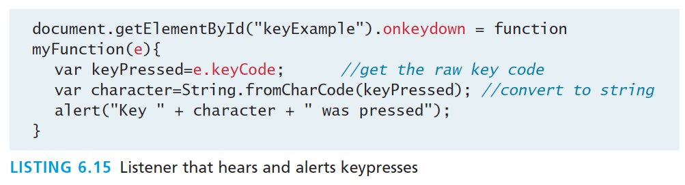
Keyboard events
Example
<input type="text" id="keyExample">
The input box above, for example, could be listened to and each key pressed echoed back to the user as an alert as shown in Listing 6.15.

Slide 99
Form Events
Event | Description
onblur | A form element has lost focus (that is, control has moved to a different element, perhaps due to a click or Tab key press.
onchange | Some <input>, <textarea> or <select> field had their value change. This could mean the user typed something, or selected a new choice.
onfocus | Complementing the onblur event, this is triggered when an element gets focus (the user clicks in the field or tabs to it)
onreset | HTML forms have the ability to be reset. This event is triggered when that happens.
onselect | When the users selects some text. This is often used to try and prevent copy/paste.
onsubmit | When the form is submitted this event is triggered. We can do some pre-validation when the user submits the form in JavaScript before sending the data on to the server.

Slide 100
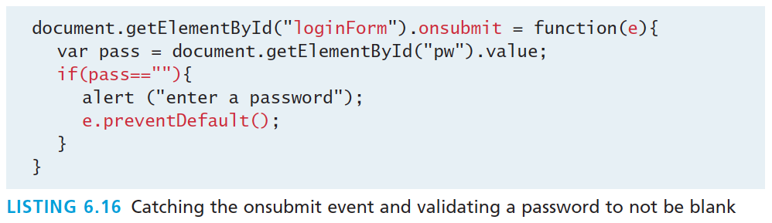
Form Events
Example

Slide 101
Frame Events
Frame events are the events related to the browser frame that contains your web page.
The most important event is the onload event, which tells us an object is loaded and therefore ready to work with. If the code attempts to set up a listener on this not-yet-loaded <div>, then an error will be triggered.
window.onload= function(){
//all JavaScript initialization here.
}

Slide 102
Frame Events
Table of frame events
Event | Description
onabort | An object was stopped from loading
onerror | An object or image did not properly load
onload | When a document or object has been loaded
onresize | The document view was resized
onscroll | The document view was scrolled
onunload | The document has unloaded

Slide 103
Forms
Section 8 of 8

Slide 104
Validating Forms
You mean pre-validating right?
Writing code to prevalidate forms on the client side will reduce the number of incorrect submissions, thereby reducing server load.
There are a number of common validation activities including email validation, number validation, and data validation.

Slide 105
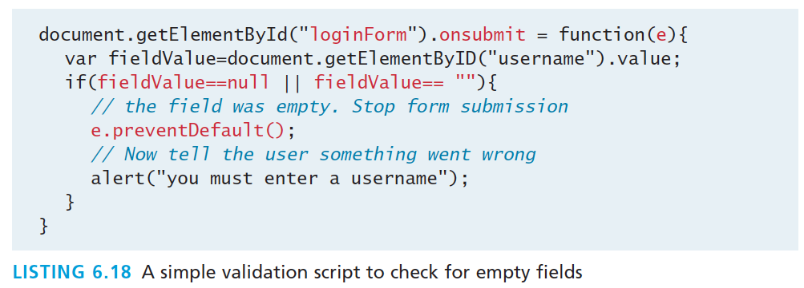
Validating Forms
Empty field

Slide 106
Validating Forms
Empty field
If you want to ensure a checkbox is ticked, use code like that below.
var inputField=document.getElementByID("license");
if (inputField.type=="checkbox"){
if (inputField.checked)
//Now we know the box is checked
}

Slide 107
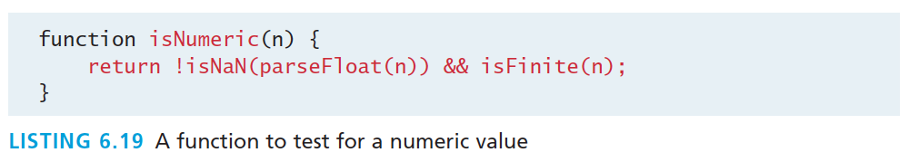
Validating Forms
Number Validation

Slide 108
Validating Forms
More to come in Chapter 12
Form validation uses regular expressions, covered in Chapter 12

Slide 109
Submitting Forms
Submitting a form using JavaScript requires having a node variable for the form element. Once the variable, say, formExample is acquired, one can simply call the submit() method:
var formExample = document.getElementById("loginForm");
formExample.submit();
This is often done in conjunction with calling preventDefault() on the onsubmit event.

Slide 110
What you Learned
1
2
What is JavaScript
JavaScript Design
3
4
Using
JavaScript
Syntax
5
6
JavaScript
Objects
The DOM
7
7
JavaScript
Events
8
Forms

